Slide 1
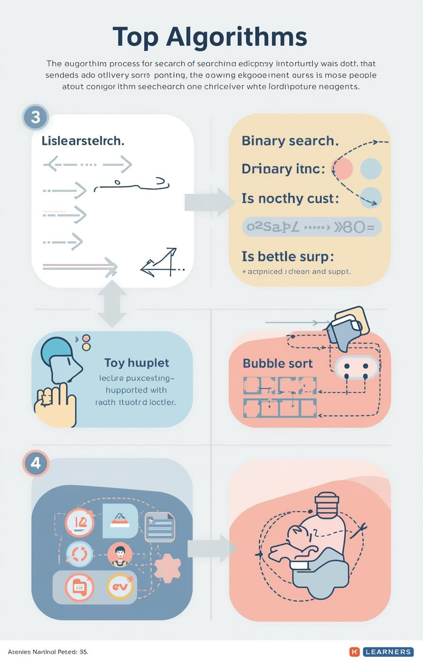

Algorithms: Searching and Sorting
by Mr. Edward Paul

Slide 2

Understanding Algorithms
Their Importance in Computer Science
Algorithms are essential, defined as step-by-step procedures for solving problems. They enable computers to efficiently process information, making them a fundamental aspect of computer science and programming.
2

Slide 3

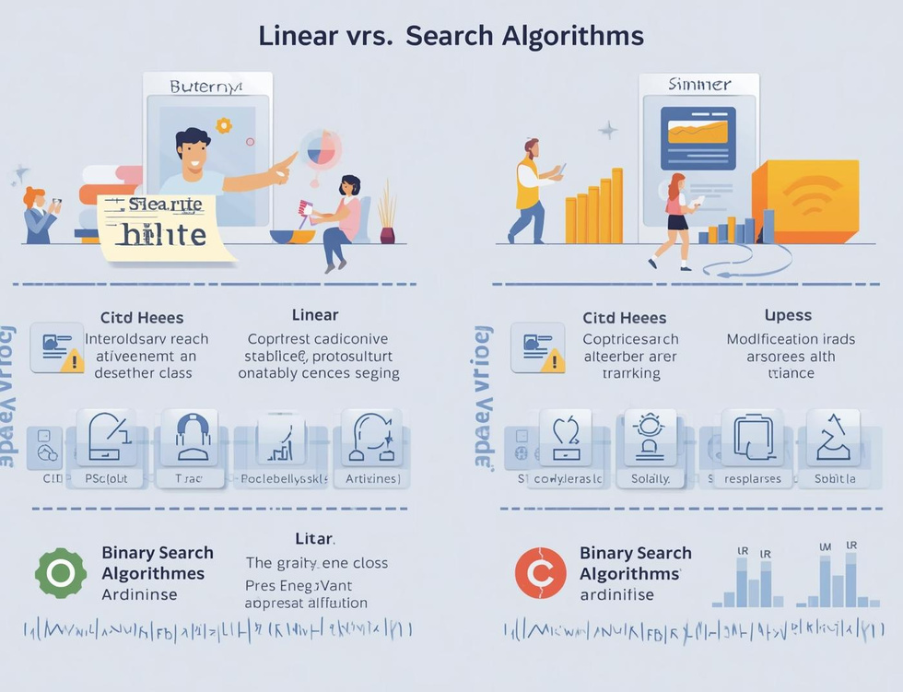
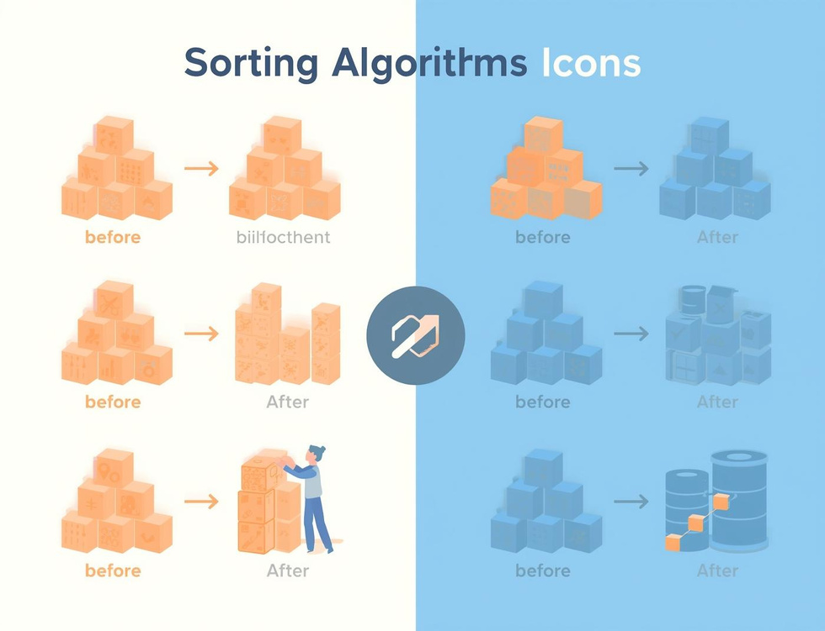
Learning Objectives
Search Algorithms
Compare Efficiencies
Bubble Sort
Understand how algorithms locate data effectively through different searching techniques.
Learn the efficiency differences between linear and binary search methods in data retrieval.
Understand the basics of bubble sort and how it organizes data through comparisons.

Slide 4
Linear Search
Sequential Scanning for Data Retrieval
Definition
Simple Mechanism
Use Cases
Linear search is a straightforward algorithm that checks each element in a list sequentially until it finds the target value or reaches the end of the list.
This method is easy to implement but can be inefficient for large datasets, as it might require examining every single item before locating the desired information.
Linear search is particularly useful for small or unsorted datasets where quick implementation is necessary, making it an ideal choice for simple search tasks.
4

Slide 5
Binary Search
Divide and Conquer Method Explained
Definition
Mechanism
Requirements
Binary search is a fast search algorithm that finds the position of a target value within a sorted array, using a divide-and-conquer strategy for efficiency.
The algorithm repeatedly divides the search interval in half; comparing the target value to the middle element, it narrows down the potential location until the target is found.
For binary search to work, the data must be sorted beforehand; this prerequisite allows the algorithm to efficiently eliminate half of the remaining elements with each comparison.
5

Slide 6
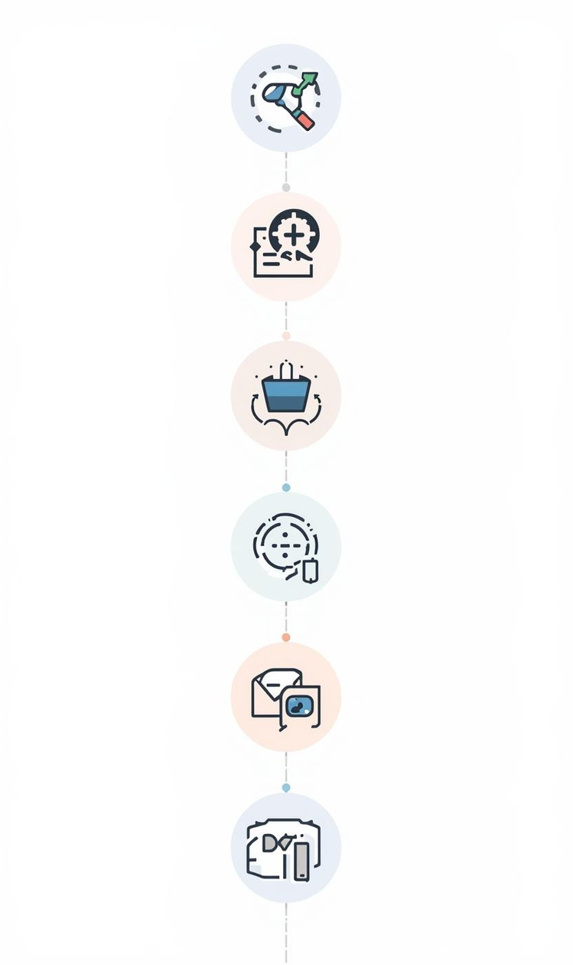
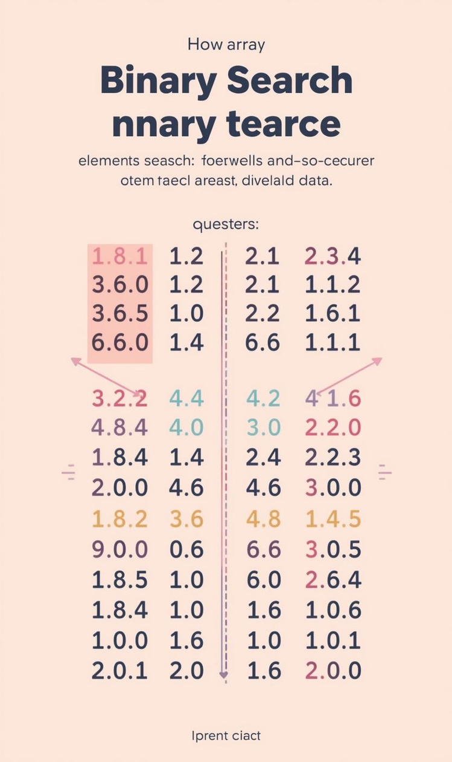

Comparing Efficiency of Search Algorithms
Efficiency
Pros and Cons
Linear search has O(n) time complexity.
Binary search is faster but needs sorted data.

Slide 7
Algorithm Tracing
Linear Search
Binary Search
Efficiency Comparison
In linear search, each element is examined sequentially until the target is found. This straightforward approach is effective for small or unsorted datasets, but can be slow for larger lists.
Binary search requires a sorted list, dividing the search space in half repeatedly, which drastically reduces the number of checks needed to find the target value, making it more efficient than linear search.
Comparing the two searches, linear search has a time complexity of O(n), while binary search operates at O(log n), highlighting the significant efficiency gained through the divide-and-conquer strategy of binary search.

Slide 8
Bubble Sort
Introducing Sorting Algorithms and Their Importance
8

Slide 9
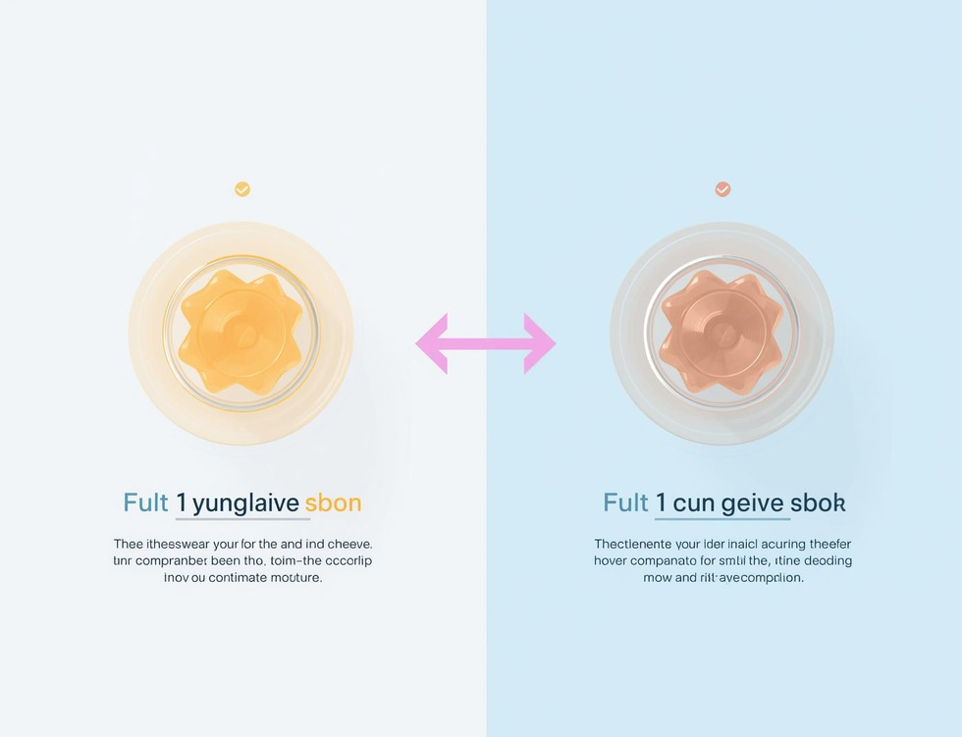
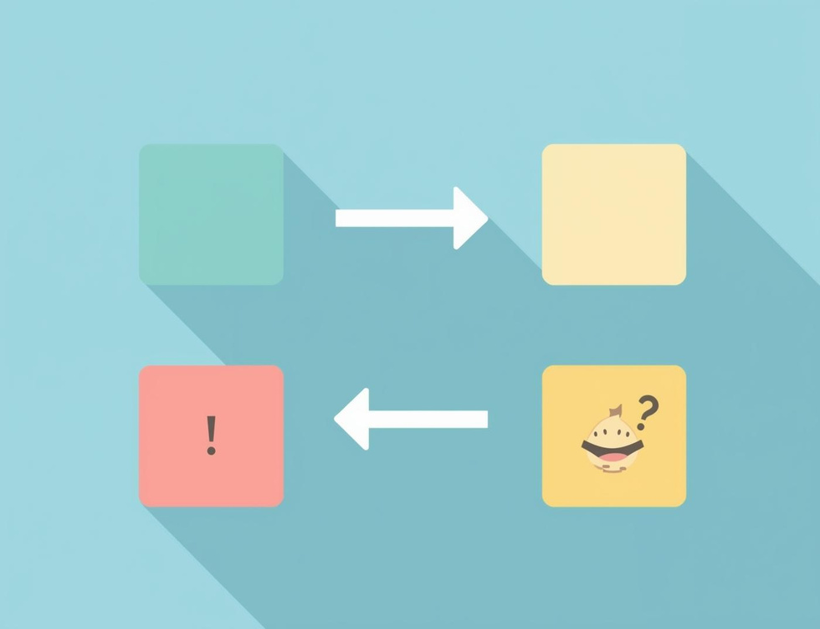
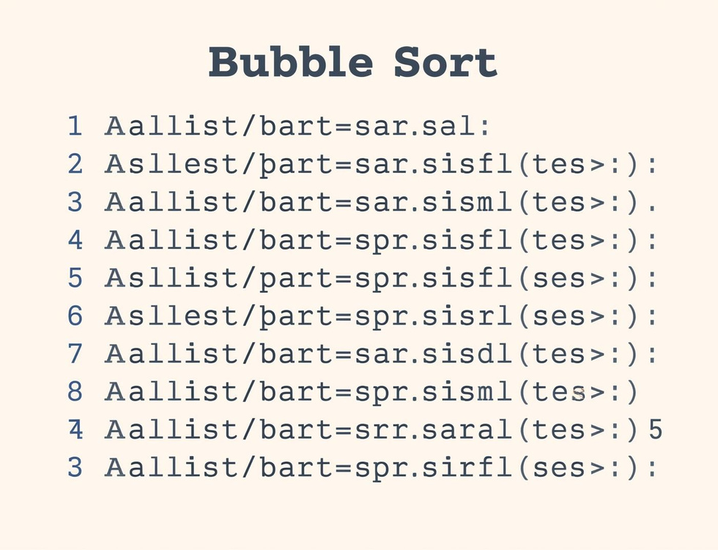
Bubble Sort Steps
Compare Elements
Swap if Needed
Repeat Passes
Compare adjacent elements to determine if they need swapping for sorting.
Elements are swapped if they are in the wrong order, ensuring sorting progress.
The sorting process continues with repeated passes until the entire list is sorted.

Slide 10
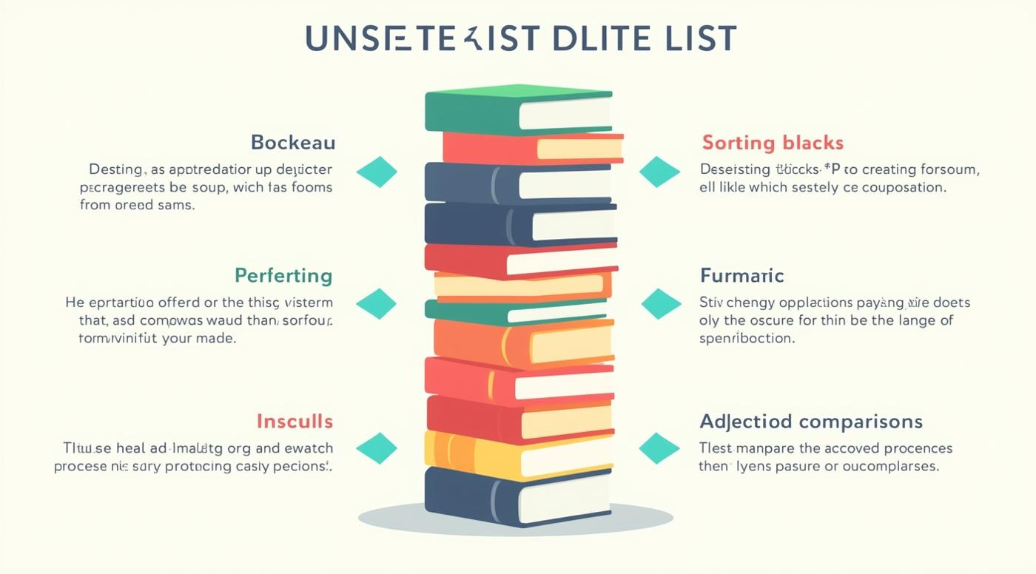
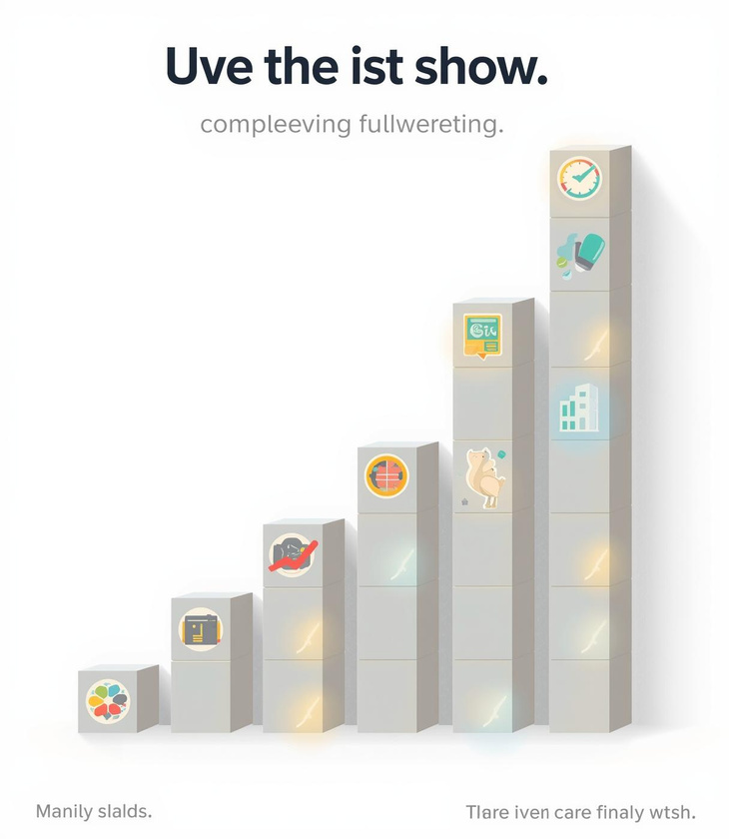
Tracing Bubble Sort Steps

Slide 11
Key Takeaways and Insights
01
Search Algorithms
Linear and binary searches each have distinct strengths.
02
Sorting Concepts
Bubble sort is an essential foundational sorting algorithm.
03
Tracing Importance
Understanding algorithms requires step-by-step tracing practice.

Slide 12

Continue Learning
Practice tracing algorithms today!

Slide 13
Lesson on Algorithm
AI-Generated Teaching Slides

Slide 14
This is a comprehensive lesson pack designed for an introductory computer scienc
---
## Lesson Pack: Understanding Algorithms
**Topic:** Algorithms
**Duration:** 50-60 minutes (can be extended with deeper activity time)
**Target Audience:** KS3/Early KS4 Computer Science/ICT Students (Ages 11-15)
---
### 1. Lesson Objectives
By the end of this lesson, students will be able to:
* **Define** what an algorithm is in their own words.
* **Identify** examples of algorithms in everyday life and in computing.
* **Explain** the key characteristics of a good algorithm (clear, finite, unambiguous).
* **Design** a simple algorithm using clear, step-by-step instructions.
* **Recognize** the importance of precision and clarity when creating instructions for others (or computers).
---
### 2. Introduction / Starter Activity (10-15 minutes)
**Title:** The Peanut Butter & Jelly Sandwich Challenge!
**Activity Description:**

Slide 15
**Teacher Prep:** Gather ingredients: loaf of bread, jar of peanut butter, jar o

Slide 16
**Challenge Setup:** Inform students that you will make a sandwich *exactly* as

Slide 17
**Student Task:** Ask the class, as a whole, to give you step-by-step instructio

Slide 18
**Teacher Demonstration:** Begin following their instructions *literally*.
* *Example interactions:* If they say "Open the bread," you might pick up the loaf but not untwist the tie. If they say "Put peanut butter on the bread," you might put the entire jar on the loaf, or just blob it on the outside of the bag. If they don't specify *which* slice, you might use an end piece.
* *Goal:* Exaggerate the literal interpretation to highlight the need for extreme precision.

Slide 19
**Debrief:**
* "What went wrong?"
* "Why was it so difficult to get me to make the sandwich correctly?"
* "What kind of instructions do we need to give so that I can make the sandwich perfectly every time?"
* **Bridge to Topic:** Introduce the idea that computers are like the teacher in this challenge – they need incredibly precise, step-by-step instructions. This set of instructions is what we call an **algorithm**.
---
### 3. Key Teaching Points (15-20 minutes)
**A. What is an Algorithm?**
* **Definition:** An algorithm is a *set of clear, step-by-step instructions* that describe how to solve a problem or achieve a specific goal.
* **Origin:** The word "algorithm" comes from the name of a Persian mathematician, Muhammad ibn Musa al-Khwarizmi, who lived around 820 AD.
* **Analogy:** Think of a recipe, a treasure map, or assembly instructions for furniture. These are all algorithms!
**B. Key Characteristics of a Good Algorithm:**

Slide 20
**Clear & Unambiguous:** Each step must be understood in only one way. No room f

Slide 21
**Finite:** The algorithm must have a definite start and a definite end. It shou

Slide 22
**Ordered Steps:** The steps must be in the correct sequence. Changing the order

Slide 23
**Input:** An algorithm usually takes some information or materials to begin wit

Slide 24
**Output:** An algorithm produces a result or an outcome. (e.g., the finished ca

Slide 25
**Effective:** Each step must be simple enough to be carried out (by a person or
**C. Algorithms in Everyday Life:**
* **Cooking Recipes:** Steps to create a meal.
* **Giving Directions:** Steps to get from one place to another.
* **Tying Shoelaces:** A sequence of actions.
* **Brushing Teeth:** A routine of steps.
* **Finding a book in a library:** Using the Dewey Decimal System or a catalogue.
**D. Algorithms in Computing:**
* **Searching:** How Google finds results for your query.
* **Sorting:** How a list of numbers or names is arranged in order.
* **Navigation Apps:** How your GPS finds the fastest route.
* **Social Media Feeds:** How platforms decide which posts to show you.
* **Gaming:** How characters move, how obstacles are generated.
* **Encryption/Decryption:** How messages are secured.
**E. Representing Algorithms (Briefly introduce):**
* **Natural Language:** Just like our sandwich instructions – simple sentences.
* **Flowcharts:** Diagrams using symbols to show steps and decisions (briefly show an example of decision, e.g., "Is toast burnt?").
* **Pseudocode:** A mix of natural language and programming-like statements (mention briefly, usually for more advanced lessons).
---
### 4. Guided Practice or Activities (15-20 minutes)
**Activity 1: Algorithm or Not? (Individual/Pair Work - 5 minutes)**
* **Task:** Provide students with a list of scenarios. They decide if each scenario describes an algorithm and, if not, why.
* **Scenarios:**
1. A recipe for chocolate chip cookies. (Algorithm)
2. A poem about a rainy day. (Not an algorithm - no problem-solving, no clear steps)
3. Instructions for assembling a flat-pack desk. (Algorithm)
4. A list of things you like to do on a sunny afternoon. (Not an algorithm - no specific goal or order)
5. The steps your computer takes to open a program when you click its icon. (Algorithm)
**Activity 2: Design Your Own Algorithm (Individual/Pair Work - 10-15 minutes)**
* **Task:** Students choose *one* of the following everyday tasks and write a clear, step-by-step algorithm for it. Emphasize clarity and precision.
* **Options:**
1. **Making a cup of tea/coffee.**
2. **Packing your school bag for the next day.**
3. **Crossing the road safely.**
4. **Brushing your teeth.**
5. **Logging onto your school computer.**
* **Differentiation:**
* **Support:** Provide a starting step or a word bank of useful verbs (e.g., "open," "take," "pour," "mix," "press").
* **Challenge:** Ask them to include a "decision" step (e.g., "Is the water boiling? If no, wait. If yes, proceed.") or identify potential ambiguities in their own algorithm.
---
### 5. Assessment Ideas
**Formative (During Lesson):**
* **Observation:** Monitor students during the sandwich challenge and the algorithm design activity. Are they grasping the concept of precision? Are their algorithms logical?
* **Q&A:** Ask targeted questions during the teaching points.
* **Mini-whiteboards:** Quick check-ins. "Write down one characteristic of an algorithm." "Is this an algorithm: 'Read a book.' Yes/No?"
* **Peer Assessment:** Have students swap their designed algorithms (Activity 2) and try to follow each other's instructions mentally or physically, noting any ambiguities.
**Summative (End of Lesson/Future Lesson):**
* **Exit Ticket:** On a small slip of paper, students write:
* "One thing I learned about algorithms today is..."
* "An algorithm is (define in your own words)..."
* "Name one everyday algorithm and one computational algorithm."
* **Short Quiz:** Multiple-choice or fill-in-the-blank questions based on definitions, characteristics, and examples.
* **Algorithm Challenge:** Give students a new, slightly more complex problem (e.g., "How to sort your school locker," "How to make a simple animation step-by-step") and ask them to design an algorithm using natural language or a simple flowchart.
---
### 6. Summary / Conclusion (5 minutes)
* **Recap Objectives:** Briefly revisit the lesson objectives to ensure students feel they've met them.
* **Key Takeaways:**
* "Remember, an algorithm is simply a clear, step-by-step set of instructions to solve a problem or achieve a goal."
* "Good algorithms are unambiguous, finite, and effective."
* "Algorithms are everywhere – from making a sandwich to powering the internet!"
* **Big Picture:** "Understanding algorithms is fundamental to computer science. When you learn to program, you're essentially writing algorithms that a computer can understand and execute."
* **Challenge Question (Optional):** "Can anyone think of a situation where a *bad* or unclear algorithm could cause a big problem in the real world?" (e.g., self-driving cars, medical equipment).
---
### 7. PowerPoint Slide Outline
**Slide 1: Title Slide**
* **Title:** Understanding Algorithms: The Art of Step-by-Step Instructions
* **Subtitle:** Learning how computers think (and how you already do!)
* **Image:** A simple, friendly robot or a flowchart icon.
**Slide 2: Lesson Objectives**
* **Title:** What We'll Learn Today
* **Bullet Points:**
* Define "algorithm."
* Identify algorithms in daily life and computing.
* Explain characteristics of good algorithms.
* Design simple algorithms.
* Appreciate precision in instructions.
**Slide 3: Starter Activity: The Sandwich Challenge!**
* **Title:** The PB&J Sandwich Challenge!
* **Bullet Points:**
* Your task: Give me instructions to make a perfect PB&J.
* I will follow them *exactly* – no assumptions!
* Let's see what happens...
* **Image:** Ingredients for a sandwich.
**Slide 4: What Went Wrong?**
* **Title:** Why Was It Tricky?
* **Bullet Points:**
* What problems did we encounter?
* Why were some instructions hard to follow?
* What do we need for *perfect* instructions?
* **Image:** A humorous, slightly messy sandwich.
**Slide 5: Introducing Algorithms**
* **Title:** So, What IS an Algorithm?
* **Bullet Points:**
* A set of **clear, step-by-step instructions**.
* To solve a **problem** or achieve a **goal**.
* Think: Recipes, assembly guides, treasure maps!
* Origin: Named after a Persian mathematician, al-Khwarizmi.
* **Image:** A magnifying glass over a step-by-step diagram, or a medieval scroll.
**Slide 6: Characteristics of a Good Algorithm**
* **Title:** The Perfect Algorithm: What Makes It Good?
* **Bullet Points:**
* **Clear & Unambiguous:** No confusion, one interpretation.
* **Finite:** Must start and end.
* **Ordered Steps:** Logical sequence.
* **Input:** Takes something to begin.
* **Output:** Produces a result.
* **Effective:** Steps can actually be carried out.
* **Image:** A checklist or tick boxes.
**Slide 7: Algorithms in Everyday Life**
* **Title:** Algorithms All Around Us!
* **Bullet Points:**
* Cooking a recipe
* Giving directions to a friend
* Tying your shoelaces
* Brushing your teeth
* Finding a book in the library
* **Image:** Collage of everyday activities.
**Slide 8: Algorithms in Computing**
* **Title:** How Computers Use Algorithms
* **Bullet Points:**
* **Searching:** Google results
* **Sorting:** Arranging lists alphabetically/numerically
* **Navigation:** GPS routes
* **Social Media:** Your feed content
* **Gaming:** Character movements, game logic
* **Image:** Icons representing search, maps, social media, games.
**Slide 9: Representing Algorithms (Brief Intro)**
* **Title:** How Do We Write Them Down?
* **Bullet Points:**
* **Natural Language:** Simple sentences (like we've been doing!)
* **Flowcharts:** Diagrams with symbols to show steps and decisions (brief example).
* **Pseudocode:** A mix of English and programming concepts (for later).
* **Image:** A very simple flowchart snippet (e.g., Start -> Step 1 -> Decision? -> Step 2 -> End).
**Slide 10: Activity 1: Algorithm or Not?**
* **Title:** Is It an Algorithm? You Decide!
* **Bullet Points:**
* Work individually or in pairs.
* Decide if each scenario is an algorithm. If not, explain why.
* (List scenarios from Activity 1 on the slide or hand them out).
* **Image:** A question mark or a "yes/no" icon.
**Slide 11: Activity 2: Design Your Own Algorithm**
* **Title:** Your Turn: Be an Algorithm Designer!
* **Bullet Points:**
* Choose ONE task:
* Making a cup of tea/coffee
* Packing your school bag
* Crossing the road safely
* Brushing your teeth
* Logging onto your school computer
* Write clear, numbered, step-by-step instructions.
* Remember the characteristics of a good algorithm!
* **Image:** A person thinking, with lightbulb.
**Slide 12: Review & Reflect**
* **Title:** Let's Recap!
* **Bullet Points:**
* What is an algorithm?
* Can you name 3 characteristics?
* Give an everyday and a computer algorithm example.
* Why is precision so important?
* **Image:** A thought bubble or a student reviewing notes.
**Slide 13: Summary & Conclusion**
* **Title:** Algorithms: The Foundations of Computing
* **Bullet Points:**
* Algorithms are fundamental to problem-solving, both human and computer.
* Clear, unambiguous instructions are key to success.
* You're already using and creating algorithms every day!
* Next time: We'll look at specific types of algorithms.
* **Image:** A powerful, abstract image representing logic or connectivity.
**Slide 14: Exit Ticket**
* **Title:** Before You Go... (Exit Ticket)
* **Bullet Points:**
* 1. Define "algorithm" in your own words.
* 2. Name one thing you learned about algorithms today.
* 3. Write one question you still have about algorithms.
* **Image:** A pen writing on paper.
---

